Slide 1
OSS Tools for System Management
Sanjula Ganepola, IBM
Software Developer
sanjula.ganepola@ibm.com

Slide 2
Agenda
Current State of System Management on IBM i
Operational Monitoring with Prometheus
Data Visualization with Grafana
Event Monitoring with Manzan
Manzan + AI

Slide 3
Current State of System Management on IBM i

Slide 4
What tools are you using for monitoring your IBM i systems?
Dynatrace
Nagios
Instana
DataDog
Control4i
Syslog Reporting Manager (SRM)
Created your own
Other

Slide 5
Specialty is a collective disadvantage
Dynatrace
Nagios
Instana
DataDog
Control4i
Syslog Reporting Manager (SRM)
Created your own
Other
Each solutions has their own…
Configuration
Host installation requirements
Monitoring capabilities
Collect system metrics (active jobs, ASP consumption)
View sub system information
Identify long-running SQL
View job queue

Slide 6
Do you use Grafana?
Yes, with IBM i
Yes, but not with IBM i
No, but we want to
No, we don’t want to
No, don’t know what it is

Slide 7
Operational Monitoring with Prometheus

Slide 8

Prometheus Overview
What is it?
Leading open-source systems monitoring and alerting toolkit
Collects and stores metrics as timeseries data
Features
Multi-dimensional data model with time series data identified by metric name and labels
Provides a functional query language called PromQL
No reliance on distributed storage
Has an alert manager built-in
Easily paired with Grafana and other monitoring solutions

Slide 9
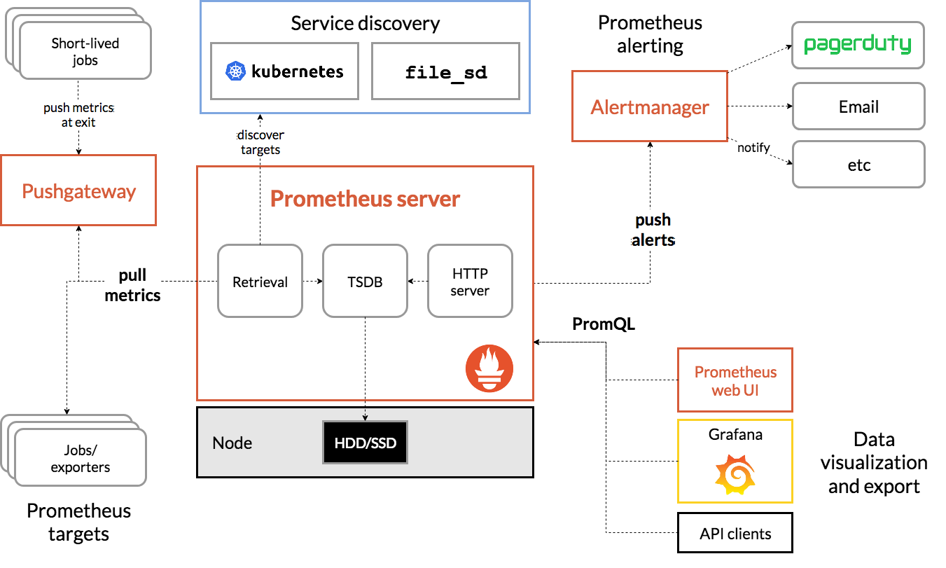
Prometheus Architecture

Slide 10
Prometheus Data Model
All data is stored as a time series: (timestamp, value)
Each time series has a name (metric name)
General feature of a system that is measured
Each time series can have key/value pairs (metric labels)
Identifies a particular dimension of the metric
Notation: <metric name>{<label name>=<label value>, ...}
api_http_requests_total{method="POST", endpoint="/messages"}
Time series is uniquely identified by metric name + metric label
temperature{city="Toronto"}
temperature{city="Rochester"}
Ordered by timestamp
Integer or fractional value

Slide 11
PromQL (Prometheus Query Language)
Functional query language that lets the user select and aggregate time series data in real time
Types:
Instant query: Evaluated at one point in time
Range query: Evaluated at equally-spaced steps between a start and an end time
Usage:
Get/filter metrics we are interested in
Aggregate metrics
Build dashboards
Setup alerts
🛢️
Relational Database
SQL
🛢️
Time Series Database
PromQL

Slide 12
PromQL Basics
SQL | PromQL
select * from http_server_request_count | http_server_quest_count
select * from http_server_request_count where uri=“/api/people” | http_server_quest_count{uri=“/api/people”}
select * from http_server_request_count where uri=“/api/people” and method=“GET” | http_server_quest_count{uri=“/api/people”,method=“GET”}
select * from http_server_request_count where status like ‘2%’ or status like ‘3%’ or status like ‘4%’ | http_server_quest_count{status=~“2..|3..|4..”}

Slide 13
More PromQL Basics
WIP
Instant query → Instant vector
Range query → Range vector

Slide 14

How to use Prometheus with IBM i

Slide 15
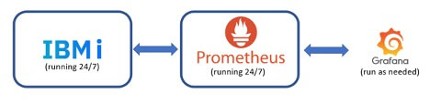
Monitoring IBM i with Prometheus
Blog post by Jesse Gorzinski: "Monitoring IBM i with Prometheus“ https://techchannel.com/Trends/12/2022/ibm-i-prometheus
Simplified view
Passive exporter running on IBM I
Prometheus running on some central location, preferably Docker or Podman
Grafana running somewhere, preferably Docker or Podman

Slide 16








Prometheus can be the bridge to other solutions

Slide 17
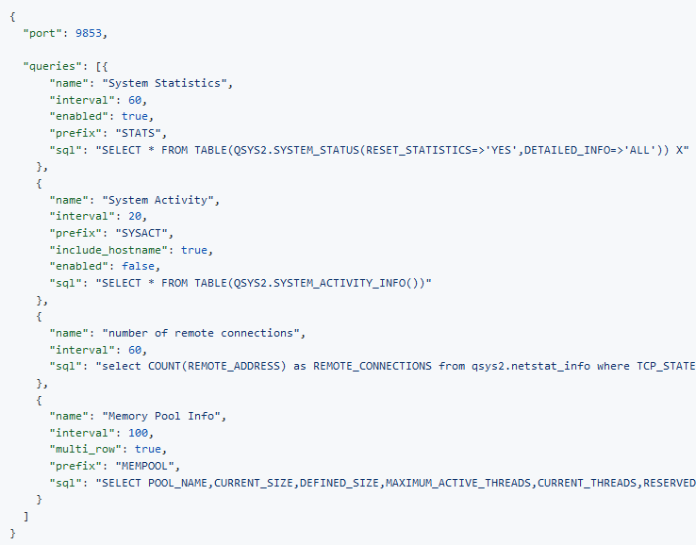
JDBC Prometheus Exporter
https://github.com/ThePrez/prometheus-exporter-jdbc
An interface for passive metric collection which allows Prometheus to scrape it
Deploys on IBM I
Exports over 400 metrics
Customizable metrics with SQL
Demo: http://ibm.biz/ibmi-prometheus

Slide 18
Data Visualization with Grafana

Slide 19
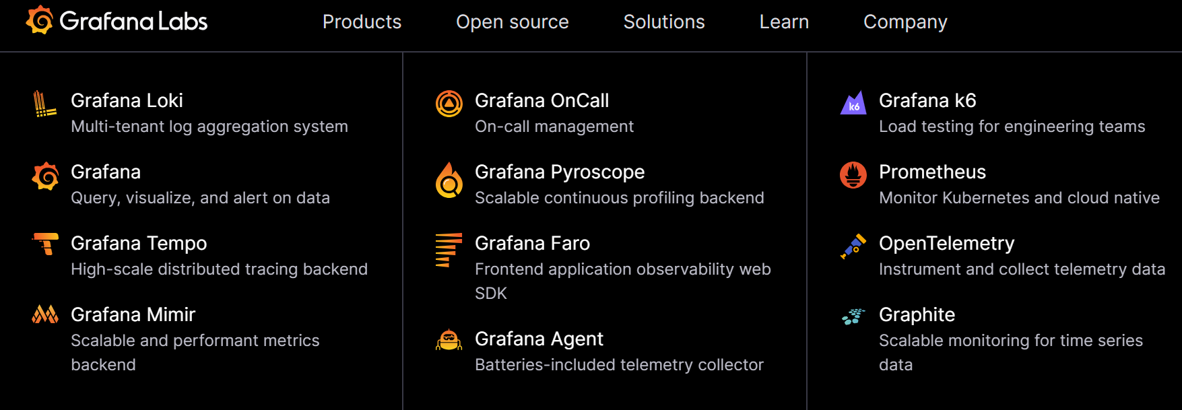
Grafana Overview
Open-source analytics, visualization, and monitoring solution
Driven by Grafana Labs. Plenty of open-source components. See https://grafana.com/
Over 300 plugins available

Slide 20
LogQL Query Language
WIP

Slide 21
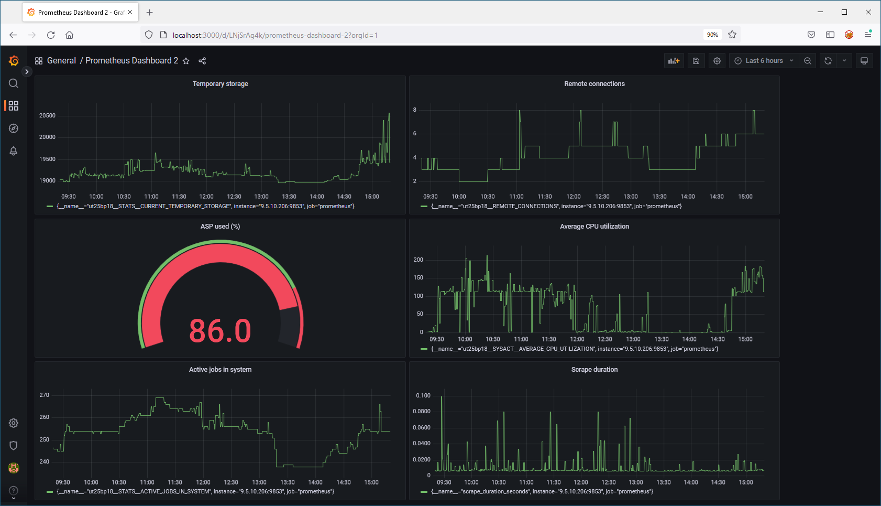
Prometheus Visualization with Grafana

Slide 22
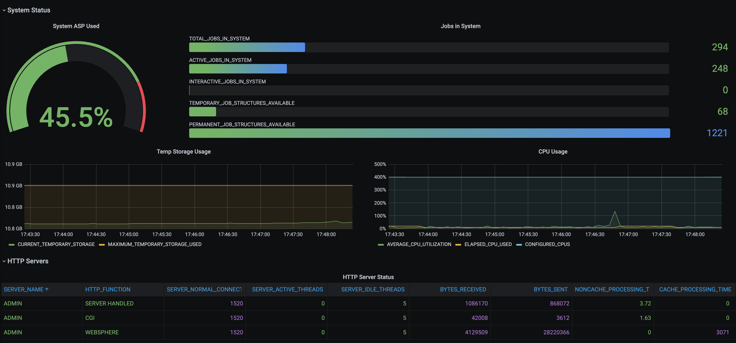
Grafana Backend (Direct, No Prometheus)

Slide 23
Grafana with or without Prometheus
 | Prometheus | Straight to Grafana
Persistent storage | Prometheus | Grafana
Persistent storage of unused metrics | Prometheus | --
Metric type | Numerics | Numerics/strings/other
Ecosystem | Extremely Broad | There
Scalability | Excellent | Good
IBM i requisites | None | Node.js
Initial setup | Easier | Easy

Slide 24
Event Monitoring with Manzan

Slide 25
Manzan Overview
Open-source event handling tool designed to simplify handling of system events
Serves as a gateway for publishing IBM i events to a variety of endpoints:
User applications
External resources
Open-source technologies
Example use cases:
Monitoring system events with a third-party open source or proprietary tool
More comprehensive integration with syslog facilities
Queryable system events
Consolidated auditing/reporting activity.

Slide 26
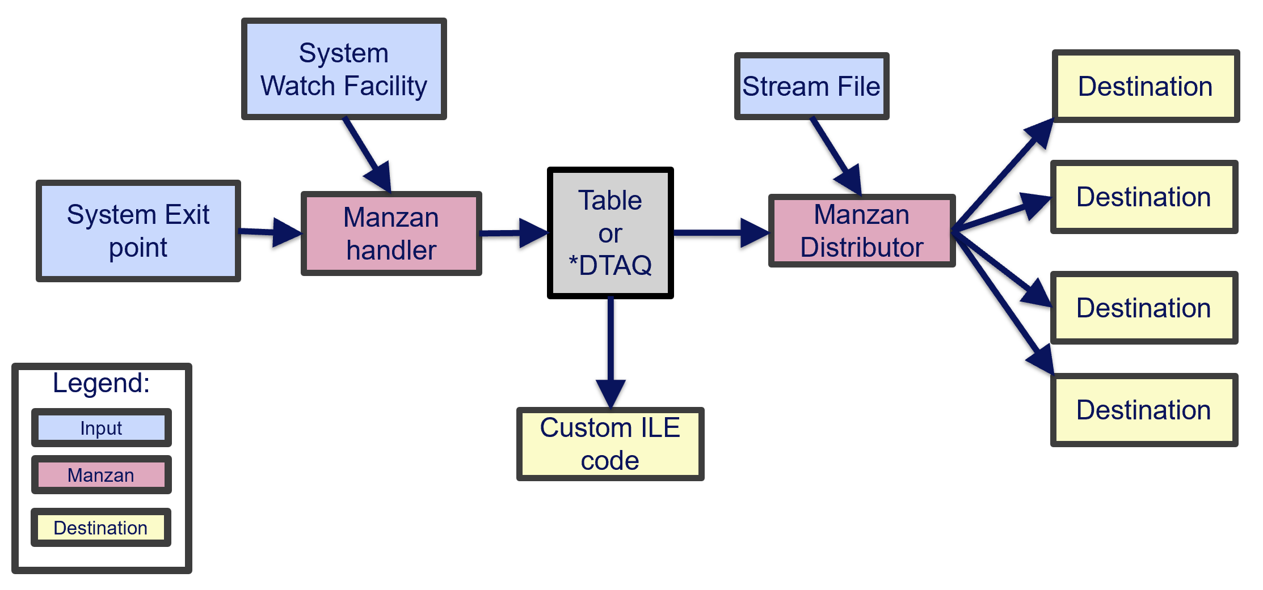
Understanding the Architecture: Inputs
Inputs: Sources of your data
Stream file
System watch facility (STRWCH)
MSGQ
LIC logs
PAL logs
System exit points
Audit journals (coming soon)

Slide 27
So practically what can Manzan monitor?
Application crashes
History Log entries
Log data
Specific entries in log data
System Limits alerts
Problem log entries
*SYSOPR messages
Specific job log messages
Audit journal events (future)
PAL entries
Fishy TCP connections (future)
VLOGs

Slide 28
Understanding the Architecture: Destinations
Destinations: Locations to send data
Supported destinations:
HTTP/HTTPS endpoints (REST, etc)
Email (SMTP/SMTPS)
SMS (via Twilio)
Slack
FluentD
Kafka
Sentry
Grafana Loki
Google Pub/Sub
ActiveMQ
Custom ILE Code

Slide 29
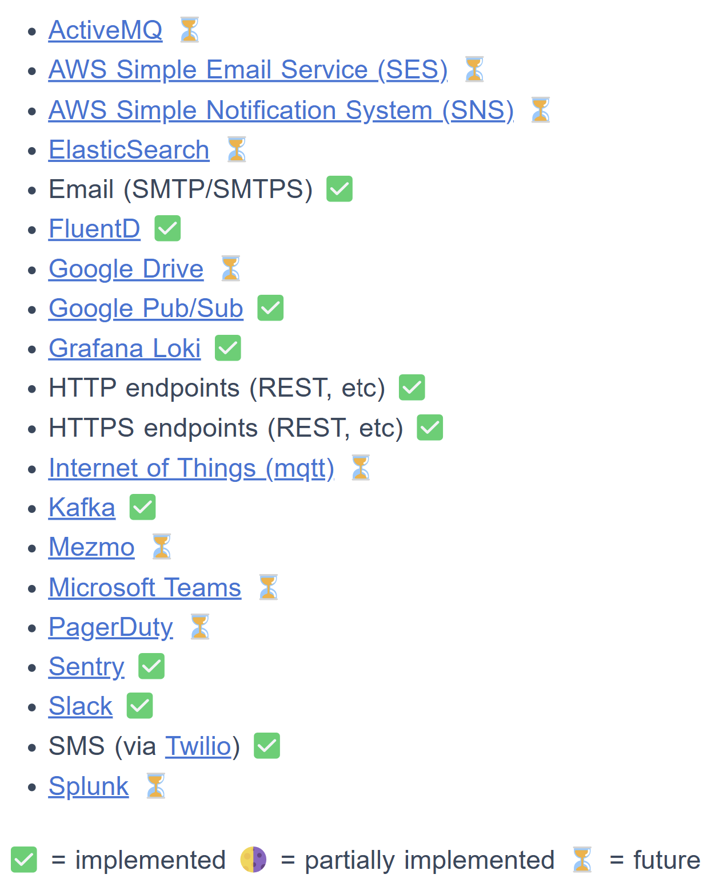
So can Manzan send data anywhere?
Many desitnations are already working, but there are more to come
Desired target not on the list? Please open an issue to the repository and let us know!
Track supported destinations: https://theprez.github.io/Manzan/#/?id=where-can-i-send-these-events

Slide 30
Understanding the Architecture: Handler and Distributor
WIP

Slide 31
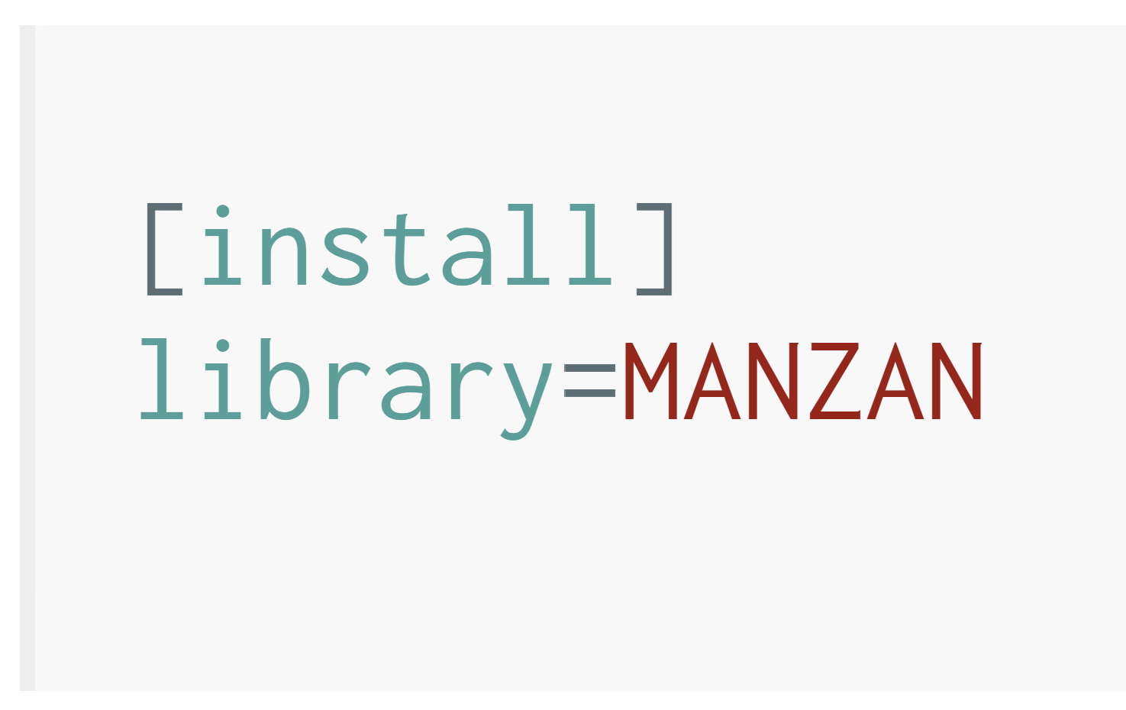
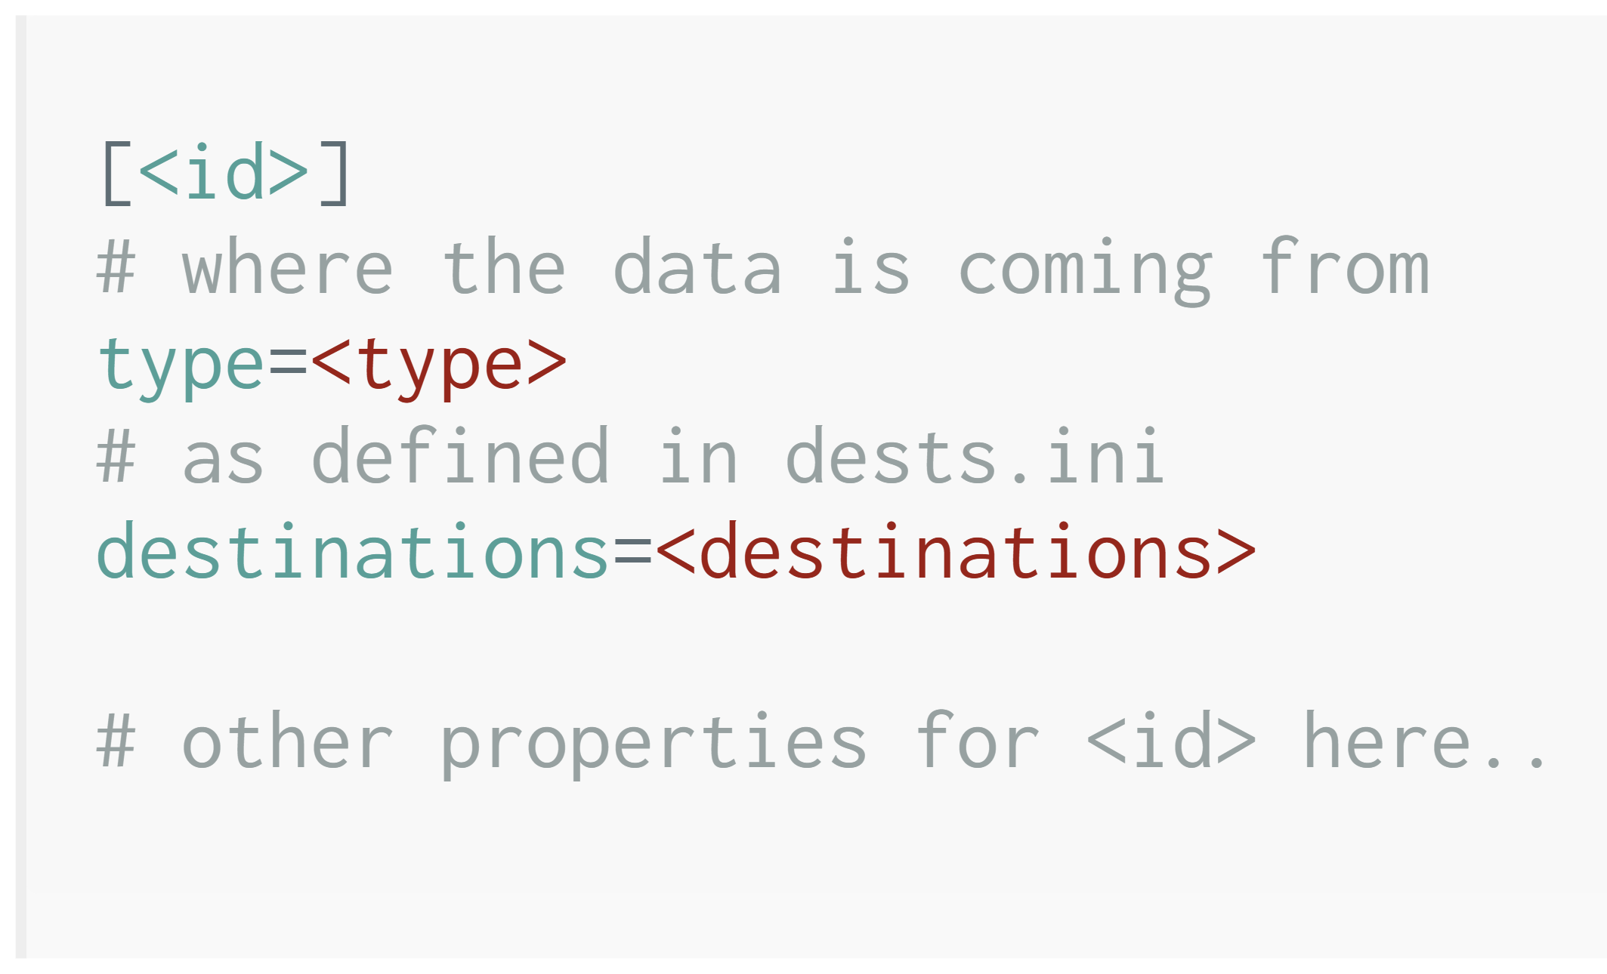
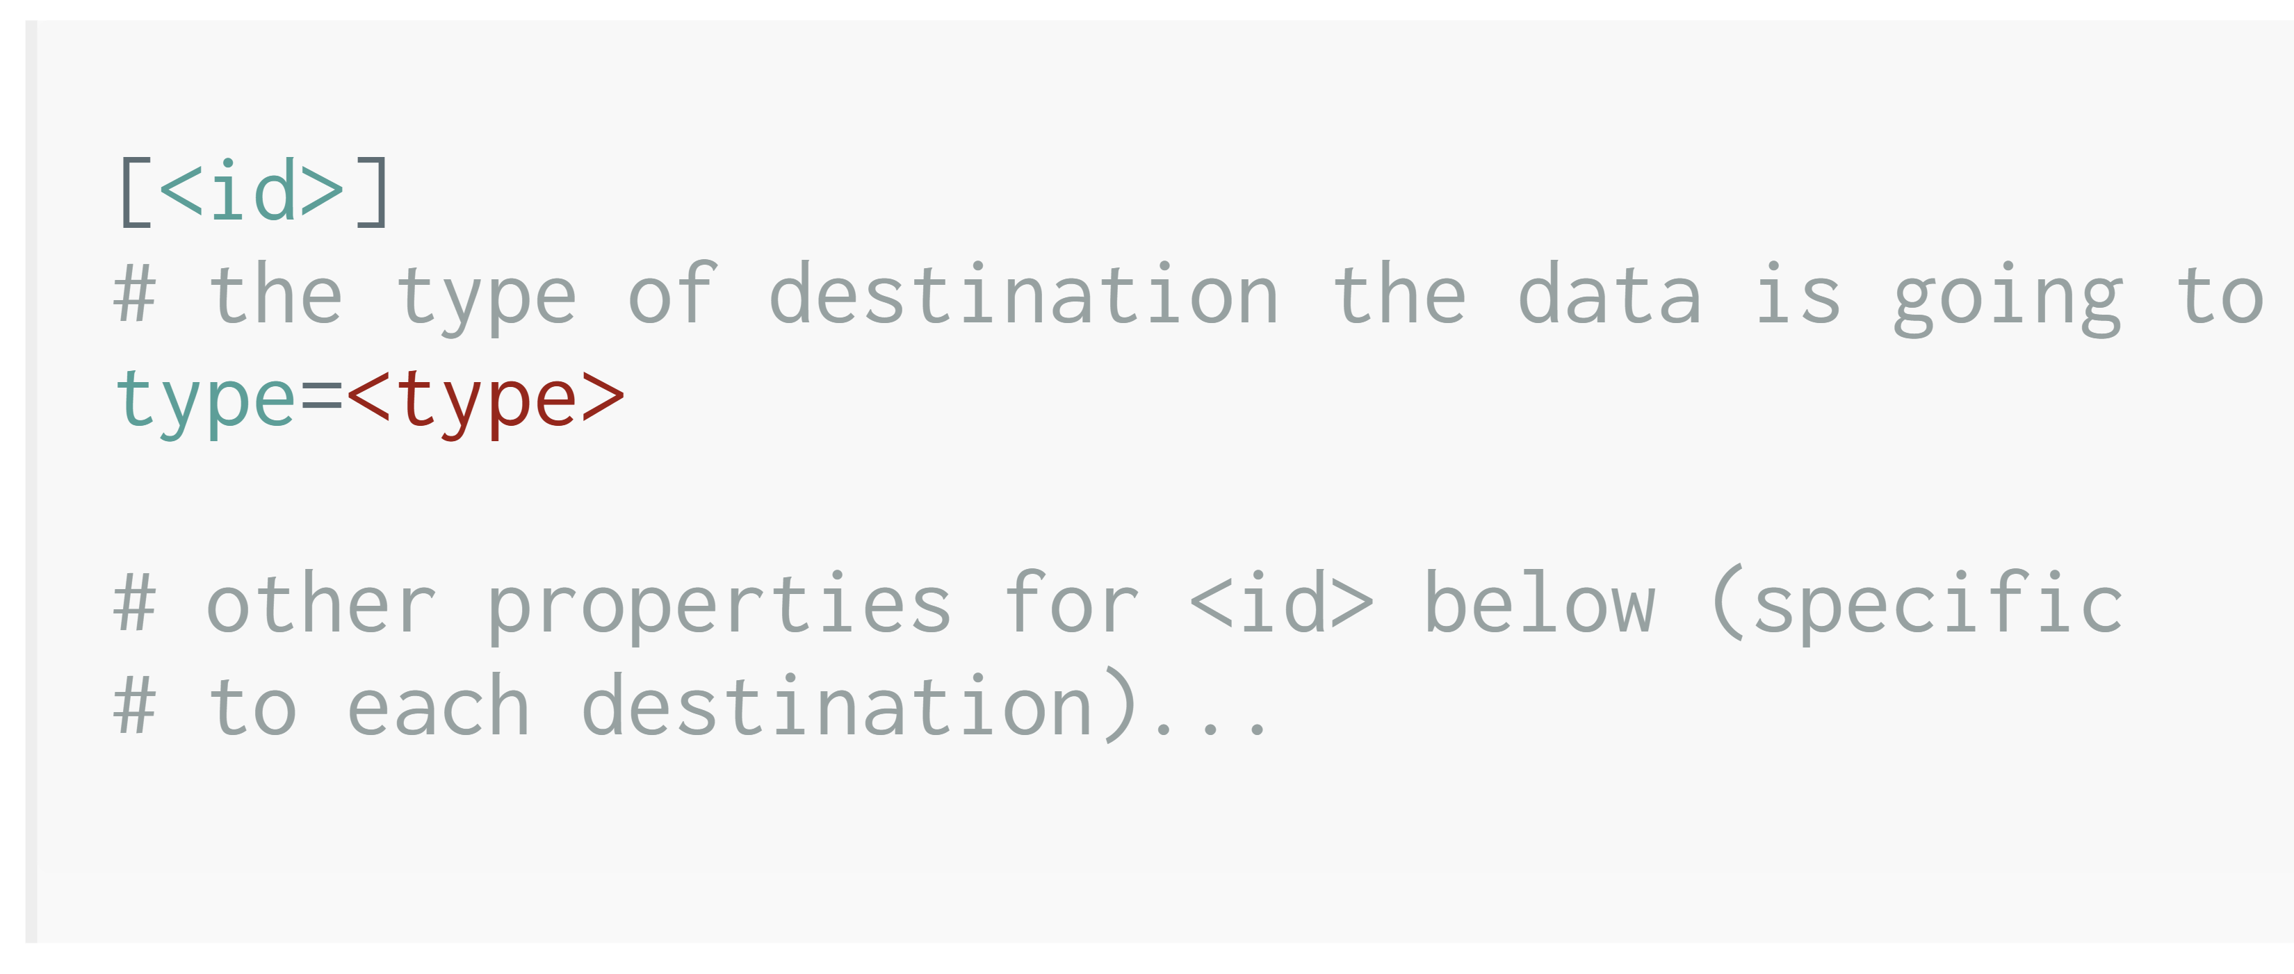
Configuring Inputs and Destinations
Configuration files are located in /QOpenSys/etc/manzan
app.ini
data.ini
dests.ini
Used for general Manzan configuration (you can leave the default contents)
Used for configuring different data sources (inputs)
Used for configuring different destinations

Slide 32
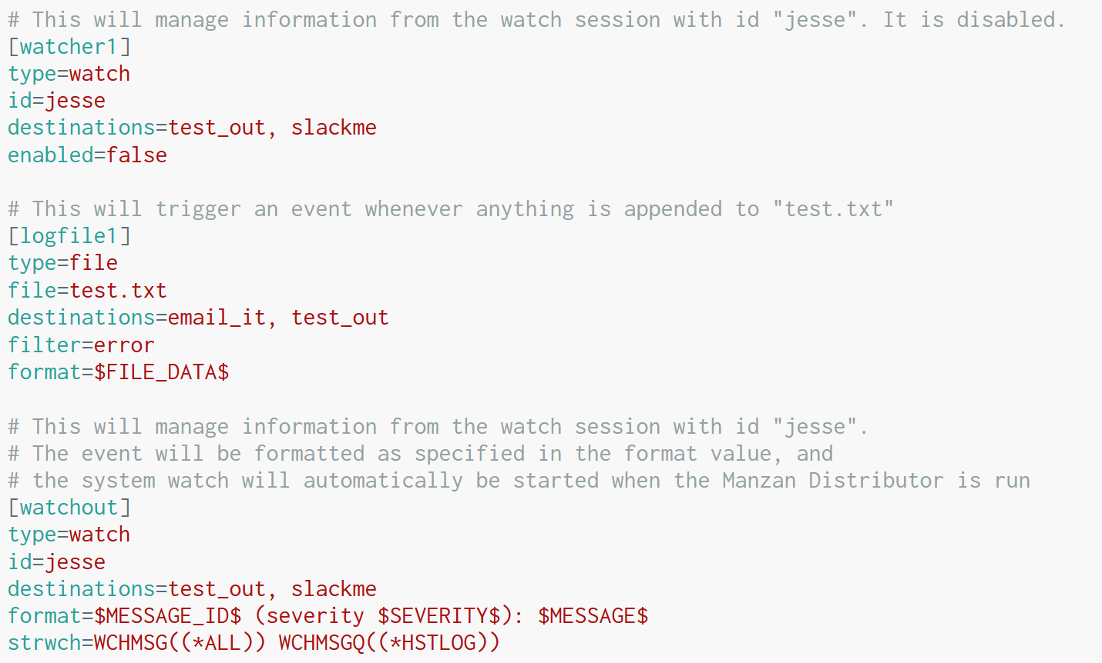
Simple data.init configuration
Stream file
Watch application log file (test.txt) and only take action when a line written to the file contains the string "error"
System Watch
Manage information from watch session with id "jesse"

Slide 33
Advanced data.init configuration
System Watch
Manage information from watch session with id "jesse", which is configured to watch all messages in the IBM i history log
Format the message into a human-sensible format
Automatically start the watch when Manzan is started

Slide 34
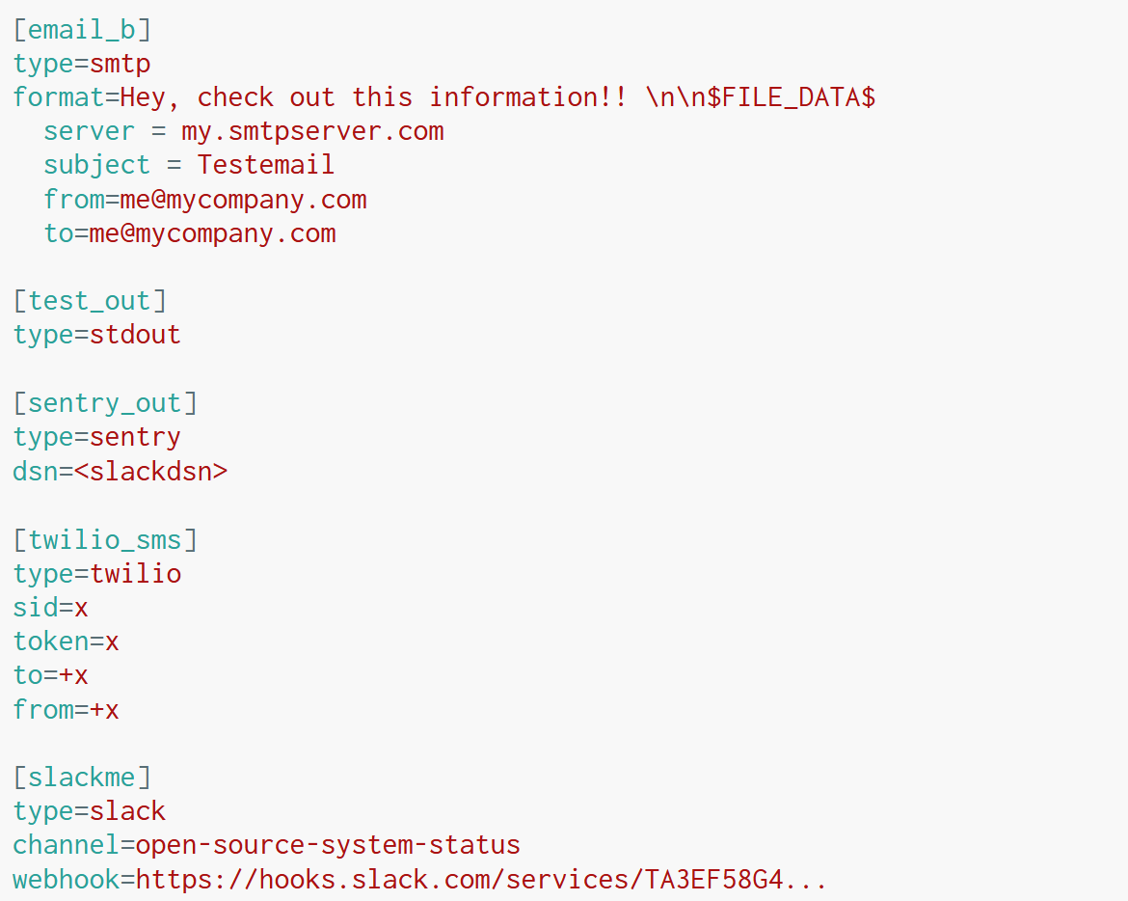
Example dests.ini configuration
Send an email
Send to Sentry

Slide 35
More example dests.ini configuration
Send SMS message with Twilio
Send to Slack

Slide 36
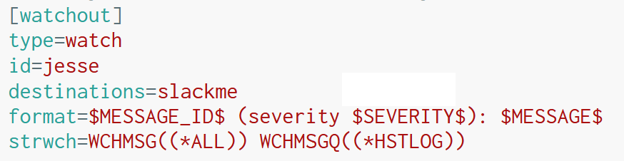
Putting it together
dests.ini
data.ini

Slide 37
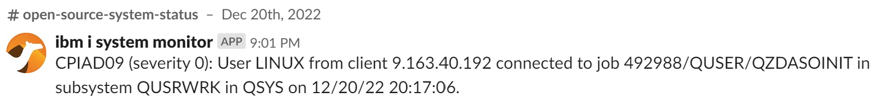
What does it look like in Slack?

Slide 38
Ingest Logs into Grafana Loki
WIP

Slide 39
Future Enhancements to Manzan
Trigger events based on audit journals
Exit point processing (currently this is completely unimplemented)
Metrics exported to Prometheus, for instance:
How many MCH exceptions have happened in production applications?
How many severity 40+ history log entries?
How many errors showing in web server logs?
How many PASE vlogs have been created?
Ability to trigger events from Prometheus exporter, for instance:
Memory pool usage anomalies
Increased HTTP server traffic
Unexpected amount of remote connections
Operational data beyond thresholds

Slide 40
Manzan + AI

Slide 41
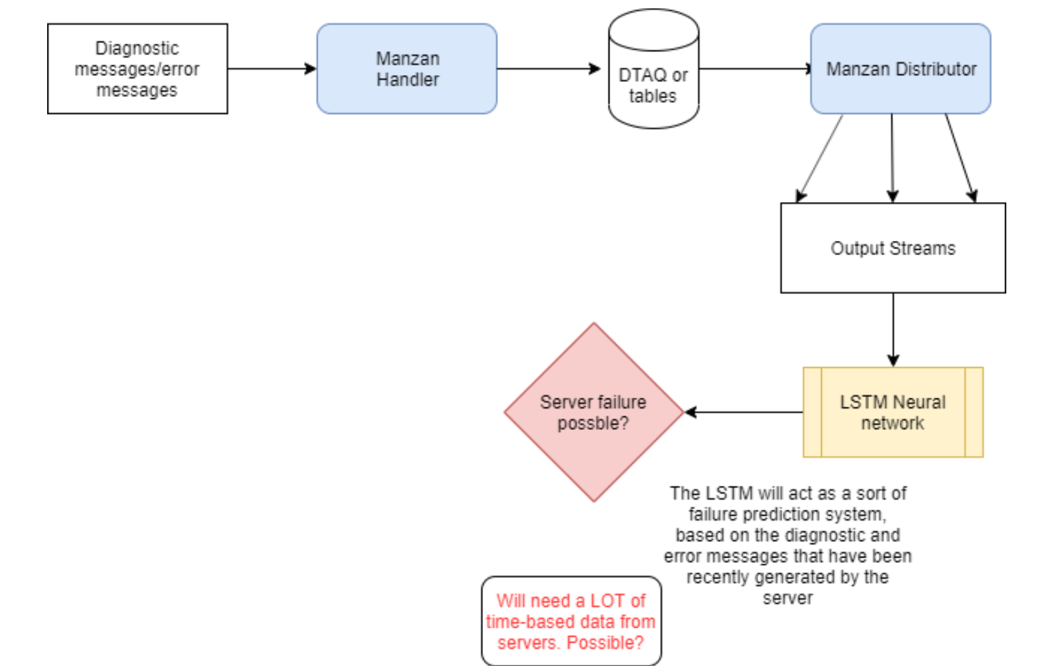
AI-Based System Monitoring: Failure Prediction System

Slide 42
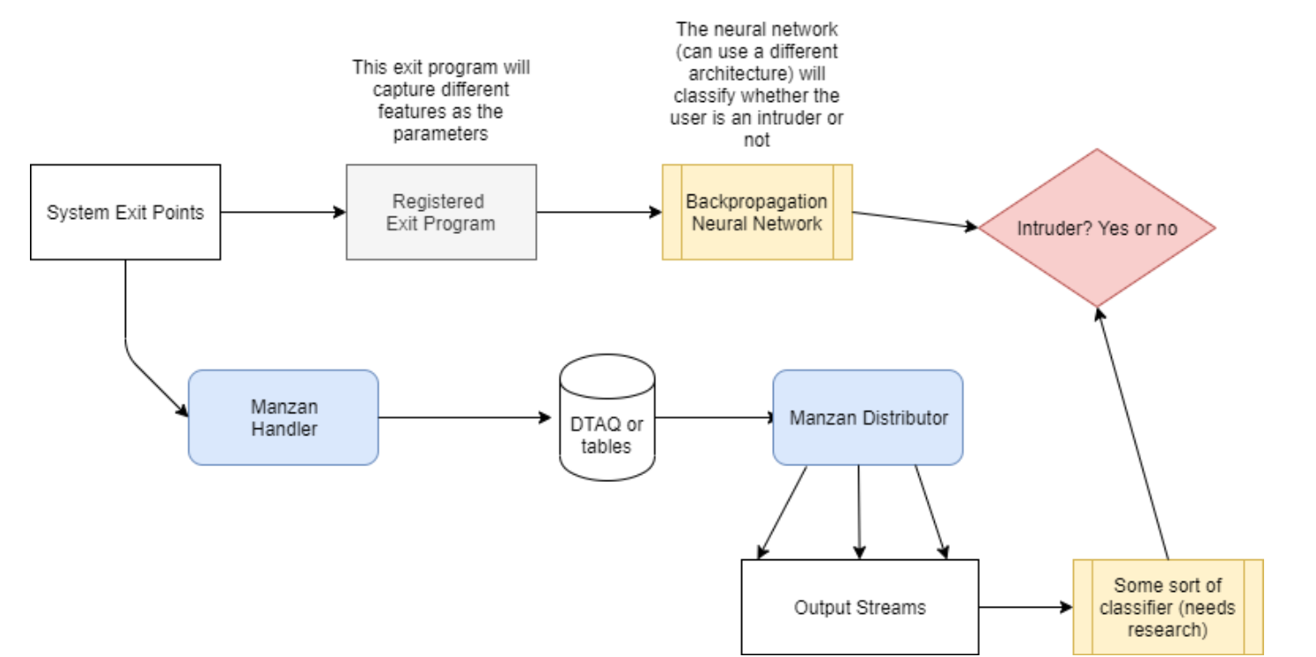
AI-Based System Monitoring: Intrusion Detection System

Slide 43
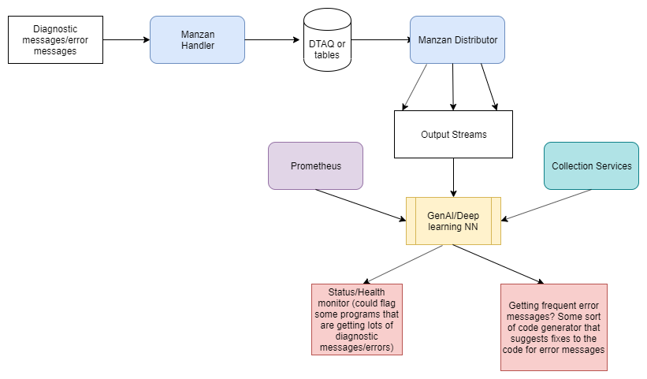
AI-Based System Monitoring: Health and Performance Assistant

Slide 44
Takeaways
Grafana is a must-have technology
01
Prometheus is a great way to enable ongoing monitoring
02
Manzan is a great way to handle various events and integrate with tons of solutions
03

Slide 45
Any Questions?

Slide 46
Important Links
ABC
WIP WIP

Slide 47

For More Information
Links You Need | Twitter | #Hashtags
IBM i Home Page: https://www.ibm.com/it-infrastructure/power/os/ibm-i (find link to Forrester Study and updated IBM i Strategy Whitepaper) IBM Strategy Whitepaper: https://www.ibm.com/it-infrastructure/us-en/resources/power/i-strategy-roadmap/ IBM Client Success: https://www.ibm.com/it-infrastructure/us-en/resources/power/ibm-i-customer-stories/ Support Life Cycle: https://www.ibm.com/support/lifecycle/ License Topics: https://www-01.ibm.com/support/docview.wss?uid=nas8N1022087 Fortra IBM i Marketplace Survey https://www.fortra.com/resources/guides/ibm-i-marketplace-survey-results | @IBMSystems @COMMONug @IBMChampions @IBMSystemsISVs @IBMiMag @ITJungleNews @SAPonIBMi @SiDforIBMi | #PowerSystems #IBMi #IBMAIX #POWER9 #LinuxonPower #OpenPOWER #HANAonPower #ITinfrastructure #OpenSource #HybridCloud #BigData

